Slide 1
List Scheduling Algorithms for Heterogeneous Systems
Team Name - Tech PiratesOS
Team Members -
Bhavana Kurra
Vijayasimha Bheemireddy
Rohan Somisetty
Rohith Reddy Venna

Slide 2
Contents
Overview
Motivation
Background
Tools and Technologies used
Methodologies
Metrics
Results
Conclusion
Future Scope

Slide 3
Overview
This project mainly deals with the implementation of task scheduling algorithms for heterogeneous systems.
The project involves studying and implementation of two list-scheduling algorithms - Predict Earliest Finish Time(PEFT) and Pre-Scheduling List Scheduling(PSLS).
For the implementation of these algorithms our project involves creation and simulation of multiple Directed Acyclic Graphs(DAG).
Over the generated DAG’s, we have observed the performance and results of the PEFT and PSLS algorithms.

Slide 4
Motivation
The primary goal of a scheduling algorithm is to reduce resource scarcity and promote fairness among those who use the resources.
Cloud computing, grid computing, edge computing, etcetera are the environments where heterogeneous computing can be applied.
Task scheduling for heterogeneous systems involves more complexity compared to that task scheduling for homogeneous systems.
The complexity involved for scheduling tasks among heterogeneous systems and errand of providing a low cost solution for such complex problem(using list scheduling algorithms) has motivated us to work on this project.

Slide 5
Back ground
Task Scheduling Algorithms
Static Scheduling algorithms
Dynamic Scheduling Algorithms
Heuristic-based algorithms
Guided Random Search based algorithms
List SCheduling Algorithms
Cluster Scheduling Algorithms
Duplicate Scheduling Algorithms

Slide 6
Tools and Technologies used
Operating System - Windows
Programming Language - Python
Anaconda Navigator
Jupyter Notebook
Google Colab
Google Cloud Platform

Slide 7
Methodologies -
Both the list scheduling algorithms have two inputs -
Directed Acyclic graph
Computation time matrix.
Later, we will be calculating attributes such as immediate predecessors of a task, immediate successors of a task, actual finish time, makespan, earliest start time, downward length table etcetera based on which we decide which task will be assigned to which processor.

Slide 8
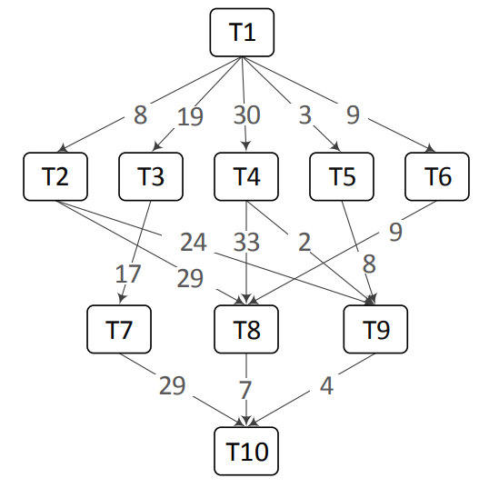
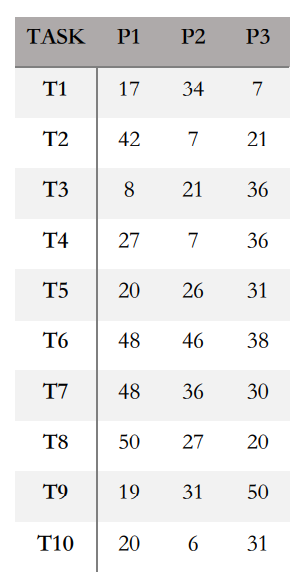
Methodologies - Input Example
Directed Acyclic Graph
Computation Cost Table

Slide 9
Methodologies - Data Generation
Number of tasks, Number of Processors, Alpha, Beta, CCR are the inputs for the data generation.
Alpha - A parameter that determines the shape of a DAG by affecting the height and width of a DAG. The width of the graph is the maximum number of tasks that can be executed concurrently. Higher value of alpha results in higher width(higher level task parallelism) of the tree resulting in a fat DAG.
Networkx library of python is used for the representation of graphs.

Slide 10
Methodologies - Data Generation
The following are parameters required for Computation Cost Table generation -
Beta - is a heterogeneity parameter.
Communication to Computation Ratio(CCR)
For a given CCR value, beta and task T, we calculate average communication cost from that task to its successors using the DAG. Later we compute average computation cost for the task T. Based on the average computation cost of the task and beta values we randomly generate a value that will be used for the creation of computation cost table.
We have generated approximately 28000 simulations.

Slide 11
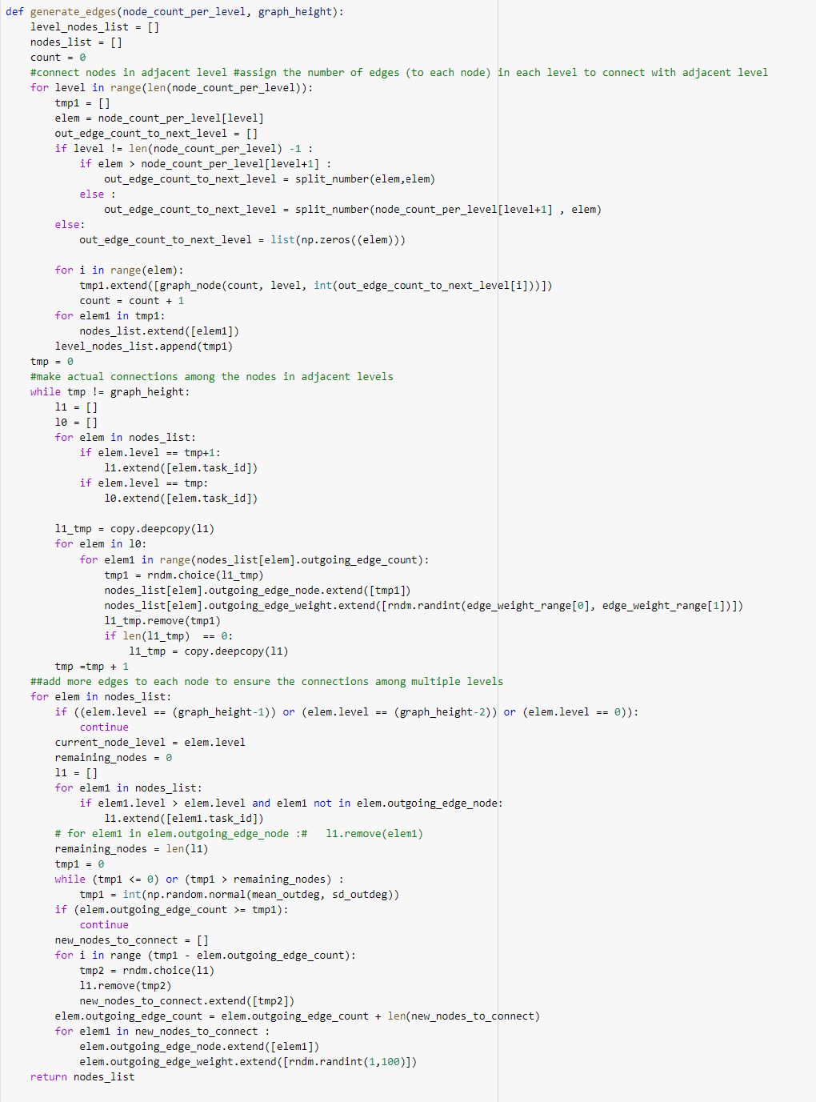
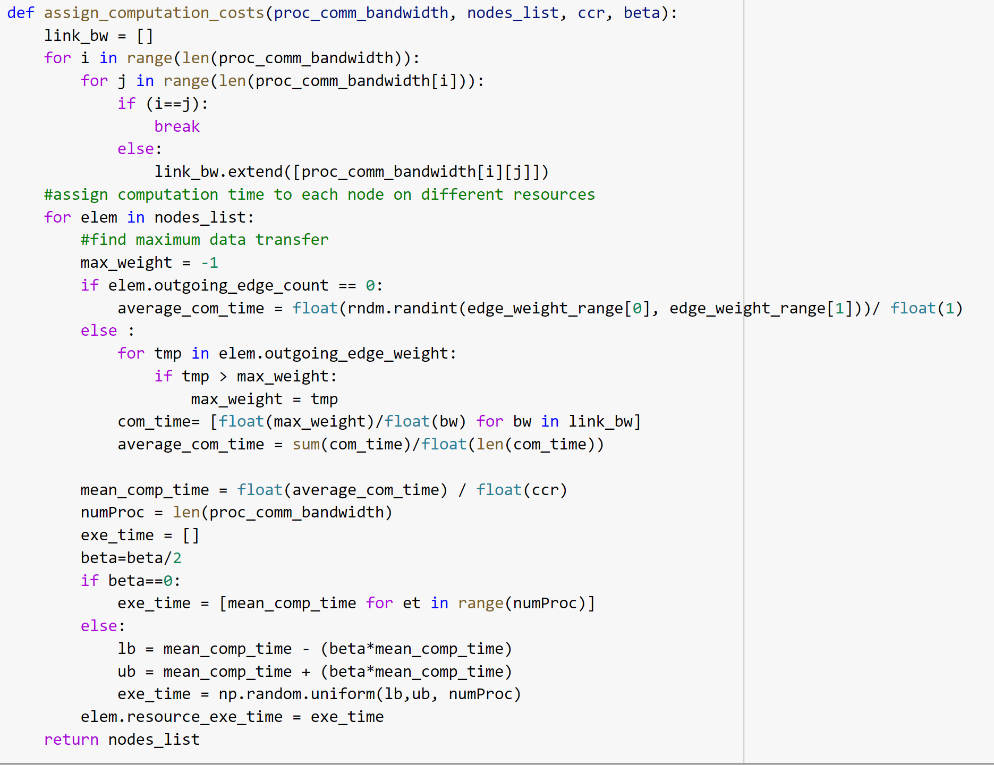
Methodologies - Data Generation - Code

Slide 12
Methodologies - Predict Earliest Finish Time(PEFT)
PEFT algorithm has two phases - task prioritizing and processor selection phase.
PEFT
Task Prioritizing Phase
Processor Selection Phase

Slide 13

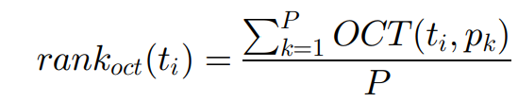
Methodologies - Predict Earliest Finish Time(PEFT) - Task Prioritizing phase
As a part of the task prioritizing phase we calculate Optimistic Cost Table(OCT).
The following is the formula for OCT-
Here, succ(t_{i}) denotes the set of immediate successors for task t_{i}. A task with no successors is called an exit task and denoted by n_{exit}.
c_{i,j} is the communication cost between the task i and task j.
c_{i,j} is zero when both the i and j tasks are being executed on the same processor and has a non-zero value otherwise. c_{i,j} can be obtained by looking at the given weighted Directed Acyclic Graph(DAG).
Using OCT we calculate rank_{OCT} using the following formula -
Based on the rank_{OCT} we create a queue of tasks. The task with highest rank_{OCT} will be given more priority.

Slide 14


Methodologies - Predict Earliest Finish Time(PEFT) - Processor Selection phase
As a part of Processor Selection phase we calculate Earliest Finish Time(EFT) and Optimistic EFT(O_{EFT}). Based on the O_{EFT} value, we assign a processor for a task.
Earliest Finish Time(EFT) - EFT is the sum of Earliest start time(EST) and the computation cost of task n_{i} on processor p_{j.} The formula for Earliest Finish Time is-
Optimistic Earliest Finish Time(O_{EFT}) - O_{EFT} for a t_{i} task on processor p_{j} is the sum of the EFT for task t_{i} on processor p_{j} and OCT of task t_{i} on processor p_{j}. The formula for O_{EFT} is -
For a given Task t, we choose the processor with the lowest O_{EFT} value..

Slide 15
Methodologies - Pre-Scheduling List Scheduling(PSLS)
PSLS algorithm has three phases - pre-scheduling, task prioritizing and processor selection phase.
PEFT
Pre-Scheduling phase
Task Prioritizing Phase
Processor Selection Phase

Slide 16
Methodologies - Pre-Scheduling List Scheduling(PSLS) - Pre-Scheduling phase
As a part of Pre-scheduling phase the following parameters are derived and used-
Processor chosen for a task using the PEFT algorithm is denoted using map1.
Actual start Time of a task derived using PEFT algorithm is denoted as AST1.
Makespan derived using PEFT algorithm is denoted as makespan1.

Slide 17

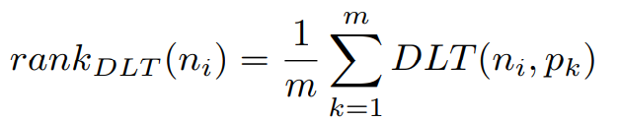
Methodologies - Pre-Scheduling List Scheduling(PSLS) - Task Prioritizing phase
As a part of the task prioritizing phase we calculate Downward Length Table(DLT).
DLT is a n×m matrix where n denotes the number of tasks and m denotes the number of processors. DLT is calculated based on the total makespan(makespan1) and the Actual Start Time of task n_{j}(AST1). The formula for the DLT is -
Using DLT we calculate rank_{DLT} using the following formula -
Based on the rank_{DLT} we create a queue of tasks. The task with highest rank_{DLT} will be given more priority.

Slide 18


Methodologies - Pre-Scheduling List Scheduling(PSLS) - Processor Selection phase
As a part of Processor Selection phase we calculate Earliest Finish Time(EFT) and Optimization Objective Function(OPT). Based on the OPT value, we assign a processor for a task.
Earliest Finish Time(EFT) - Earliest Finish Time for a given task n_{i} on the processor p_{k} is calculated as the sum of Earliest Start Time for a task n_{i} on processor p_{k} with the computational cost of task n_{i} on processor p_{k}. The formula for the EFT is -
Optimization Objective Function(OPT) - OPT for a t_{i} task on processor p_{j} is the sum of the EFT for task t_{i} on processor p_{j} and DLT of task t_{i} on processor p_{j}. The formula for OPT is -
For a given Task t, we choose the processor with the lowest OPT value.

Slide 19

Metrics
Scheduling Length Ratio(SLR) and Speedup are the two metrics that we are using for the comparison and analysis of the algorithms.
For the calculation of SLR and speedup we require two parameters called makespan and critical path.
Makespan - It is also called as schedule length which is the maximum of Actual Finish Time of all the exit tasks(n_{exit}), where the task which doesn’t have any successors called as n_{exit}. The formula for makespan is -
Critical Path - The longest path from the entry tasks to the exit tasks in a Directed Acyclic Graph(DAG) is called Critical Path.

Slide 20

Metrics
Scheduling length Ratio(SLR)
Scheduling length Ratio(SLR) is also called normalized schedule length(NSL). Makespan and minimum computation cost of the critical path tasks(CP_{MIN}) are used for calculating the Scheduled Length Ratio.
The better performing algorithm will have minimum SLR.
The following is the formula for scheduled length ratio:

Slide 21

Metrics
Speed up
For the calculation of speed up, makespan and minimum of computation time taken for all the tasks to run over a processor are used.
A higher Speedup value means a better performance of scheduling algorithm.
The following is the formula for speed up:

Slide 22
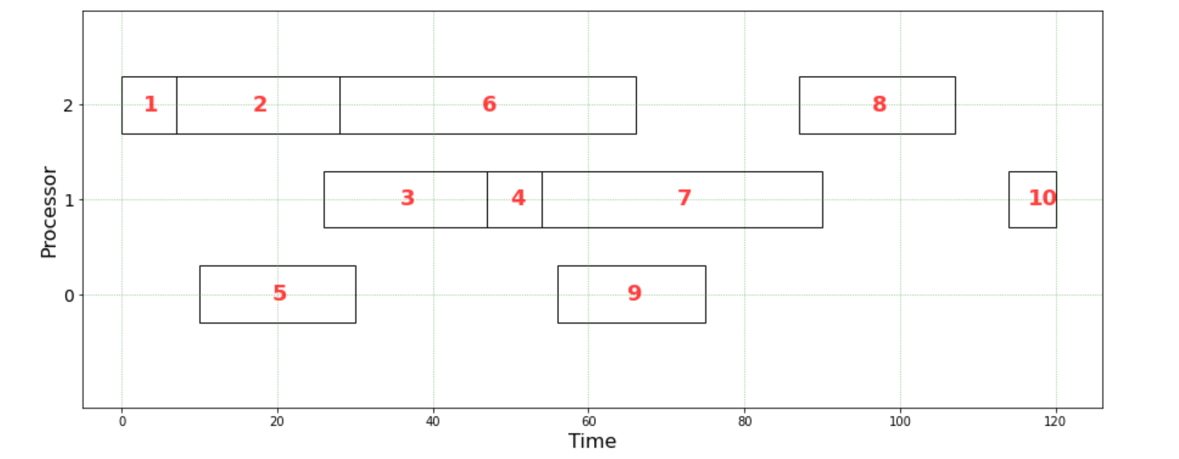
Results - PEFT
Make span = 120

Slide 23
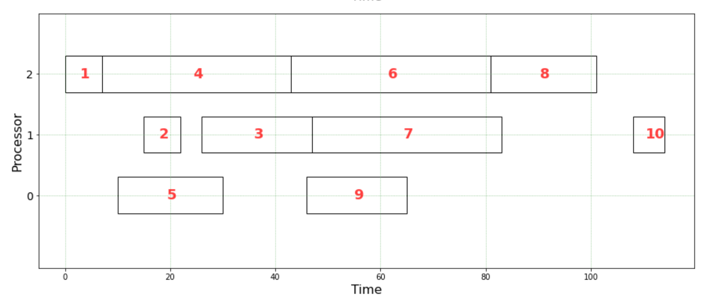
Results - PSLS
Make span = 114

Slide 24
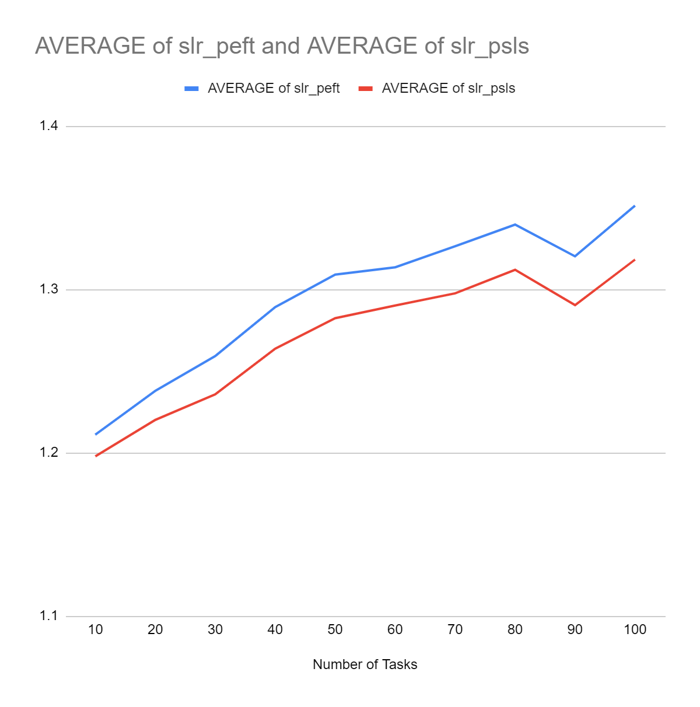
Results

Slide 25
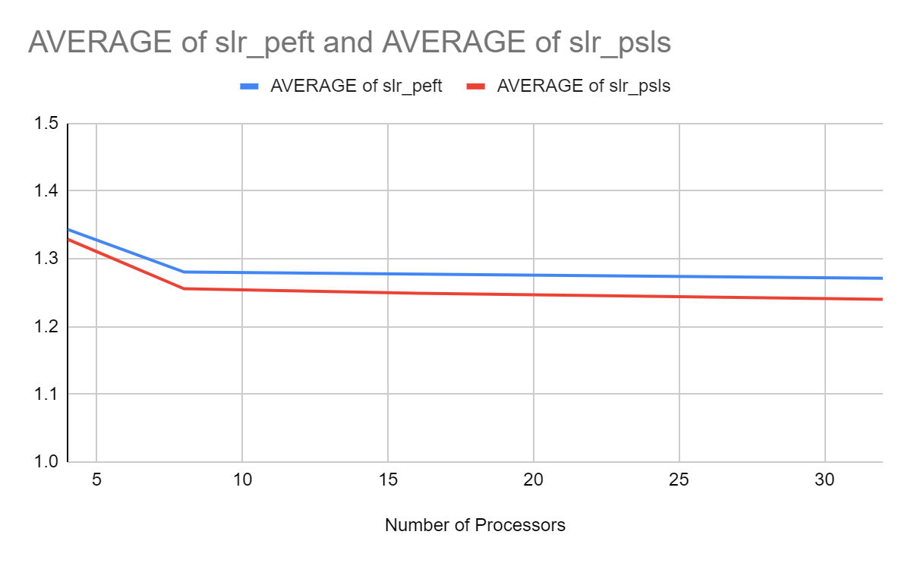
Results

Slide 26
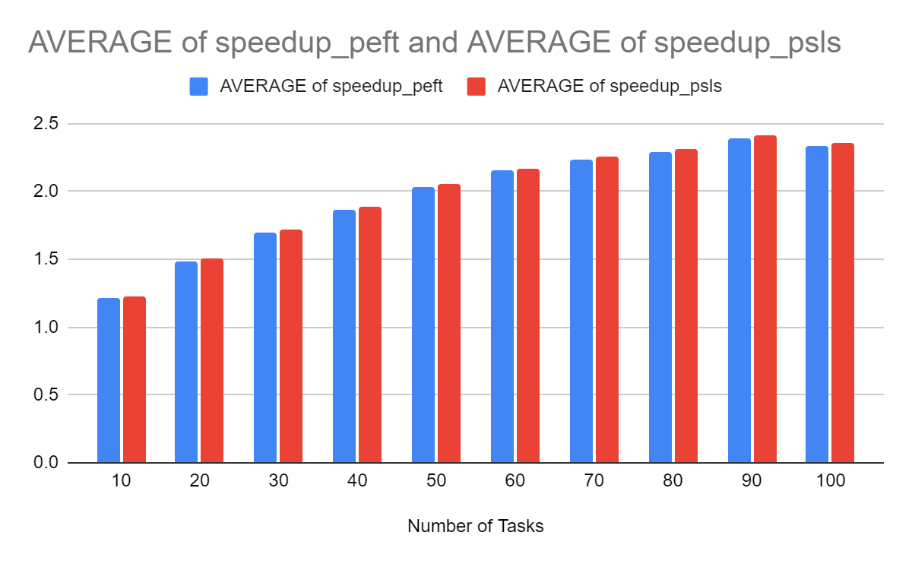
Results

Slide 27
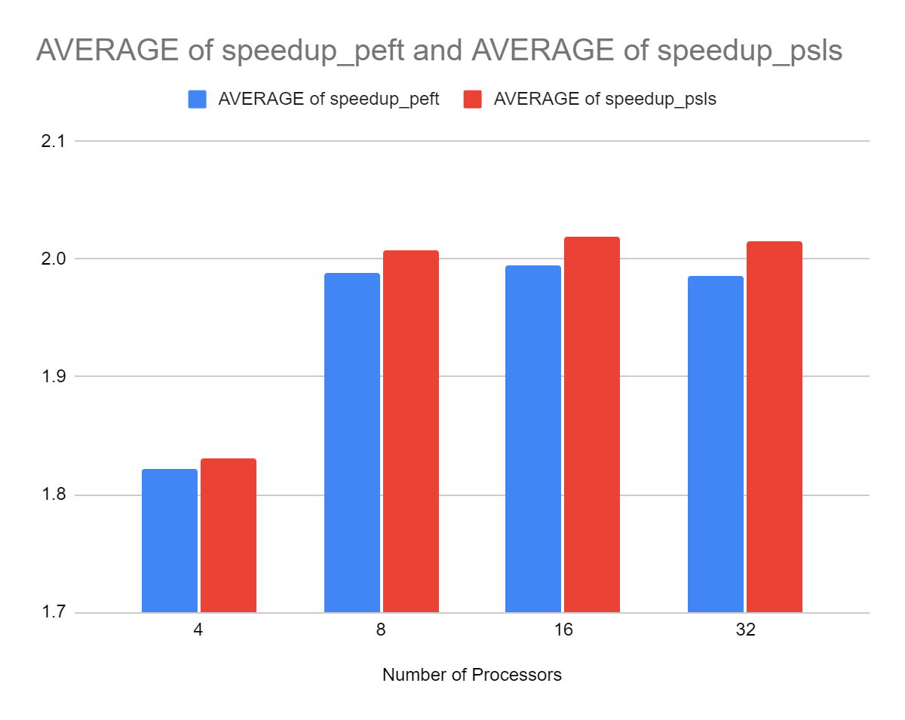
Results

Slide 28
Conclusion
The PSLS algorithm produces less makespan compared to that of the PEFT algorithm.
Also, PSLS algorithm produces less Scheduling Length Ratio(SLR) compared to PEFT algorithm.
Better speedup can be observed in PSLS algorithm than PEFT algorithm.
Therefore, we can say that PSLS performs better than PEFT algorithm having an additional phase called Pre-scheduling phase.

Slide 29
Future Scope
The PSLS and PEFT algorithms can be implemented over real-world graph applications such as gaussian elimination, fast fourier transform montage workflow, epigenomic workflow etcetera.

Slide 30
Thank you

